Slide 1
Algorithm & its analysis
Dr. B C Dhara
Department of Information Technology
Jadavpur University

Slide 2
Algorithm
An algorithm is a finite set of instructions which, if followed, accomplish a particular task.
In addition every algorithm must satisfy the following criteria:
  input: there are zero or more quantities which are externally supplied;
  output: at least one quantity is produced;
  definiteness: each instruction must be clear and unambiguous;
  finiteness: if we trace out the instructions of an algorithm, then for all cases the algorithm will terminate after a finite number of steps;
  effectiveness: every instruction must be sufficiently basic that it can in principle be carried out by a person using only pencil and paper. It is not enough that each operation be definite as in (iii), but it must also be feasible.

Slide 3
Algorithm
An algorithm can be described in different ways.
  Using natural language
  Using flowchart
  Program
  Formalized language
Algorithm analysis
  Correctness
  Readability
  Robustness
  Time and space complexity (or efficiency)

Slide 4
Algorithm
Design of an algorithm
  Incremental approach
  Recursive method
  Greedy algorithm
  Divide-and-conquer approach
  Dynamic programming approach
  and, several other techniques,….

Slide 5
Analysis of algorithm
To measure the efficiency or analyze the algorithm we use the time and space complexity of the algorithm.
There may be more than one algorithms for a particular problem, like, sorting we have several algorithms bubble sort, selection sort, insertion sort, quick sort, merge sort, etc..

Slide 6
Analysis of algorithm
To measure the complexities we are interested on theoretical analysis, not on exact value, which is not always possible to compute it (when size of input is very large).
  We are interested on asymptotic notation.
To analyze the complexity we use asymptotic notations (known as, rate of growth or order of growth)
  O (called the Big Oh)
  Ω (upper case greek letter OMEGA)
  Θ (upper case greek letter THETA)
  o (called the Little Oh)
  ω (lower case greek letter OMEGA)

Slide 7
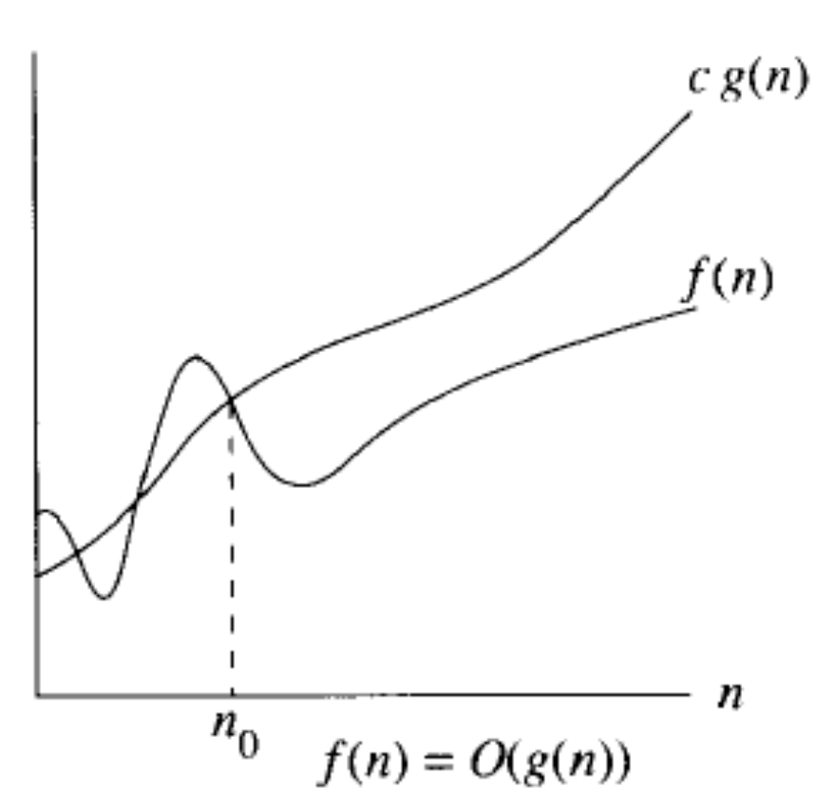
O (Big Oh) notation
O(g(n)) = {f(n): there exist positive constants c >0 and n₀ ∈N such that 0 ≤ f(n) ≤ cg(n) for all n ≥n₀}.
O-notation provides asymptotic upper bound of a function.

Slide 8
O (Big Oh) notation
Prove that T(n)=n³ + 20n + 1 is O(n³)
T(n) is O(n³), if T(n) ≤ c.n³ for some n≥ n₀ and a constant c>0.
So, n³ + 20n + 1 ≤ c.n³ ➔ 1+20/n²+1/n³ ≤ c.
If we select n≥ n₀ =1, c ≥22
If we select n₀ =10, c ≥1.201

Slide 9
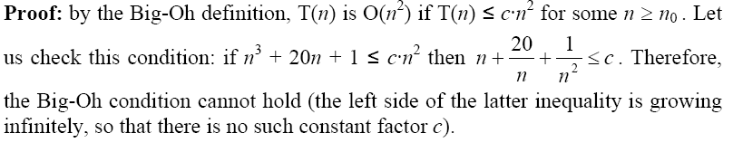
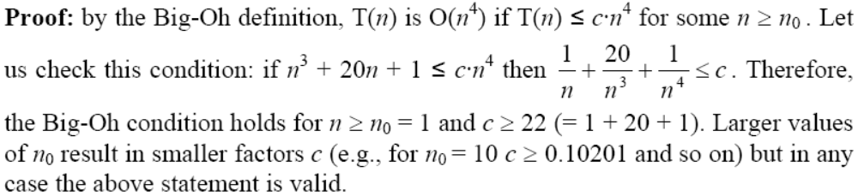
O (Big Oh) notation

Slide 10
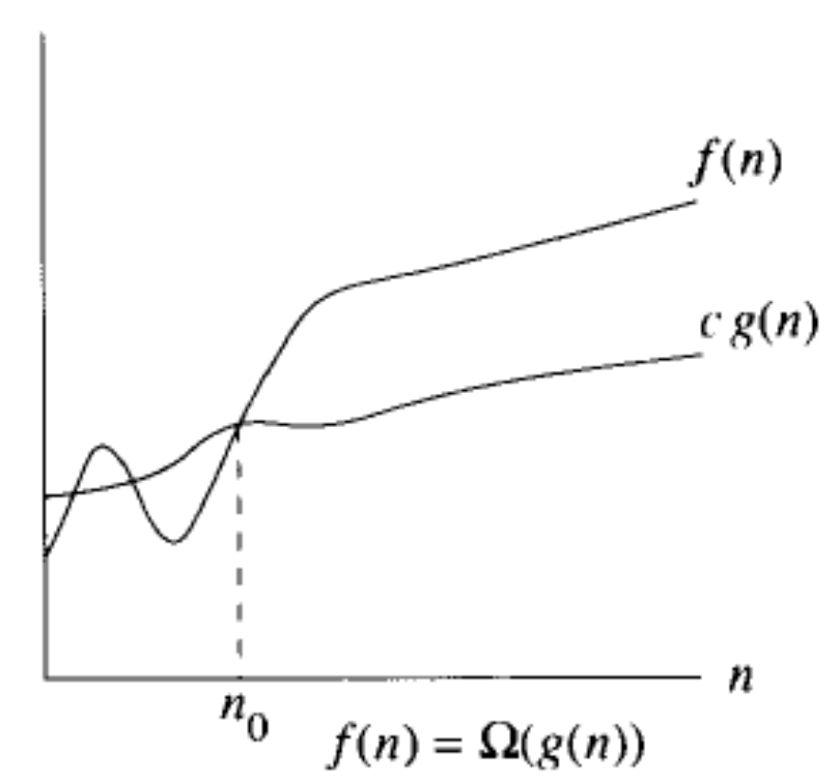
Ω-notation
Ω-notation provides an asymptotic lower bound of a function.
Ω(g(n))={f(n): there exists a constant c>0 and n₀ ∈N such that 0≤ c.g(n) ≤ f(n) for n≥ n₀

Slide 11
Ω-notation
Prove that running time T(n) = n³ + 20n is Ω(n²)
By the Big-Omega definition, T(n) is Ω(n²) if T(n) ≥ c·n² for some n ≥ n₀
Let us check this condition: if n³ + 20n ≥ c·n² then n + 20/n ≥ c.
The left side of this inequality has the minimum value of 8.94 for n = √20 ≅ 4.47
Therefore, the Big-Omega condition holds for n ≥ n₀ = 5 and c ≤ 9. Larger values of n₀ result in larger factors c (e.g., for n₀ = 10 c ≤ 12.01) but in any case the above statement is valid.

Slide 12
Ω-notation
Prove that T(n)=n³ + 20n + 1 is Ω(n³)
T(n) is Ω(n³), if T(n) ≥ c.n³ for some n≥ n₀ and a constant c>0.
So, n³ + 20n + 1 ≥ c.n³ ➔ 1+20/n²+1/n³ ≥ c.
If we select n≥ n₀ =1, c ≤ 22
If we select n₀ =10, c ≤ 1.201

Slide 13
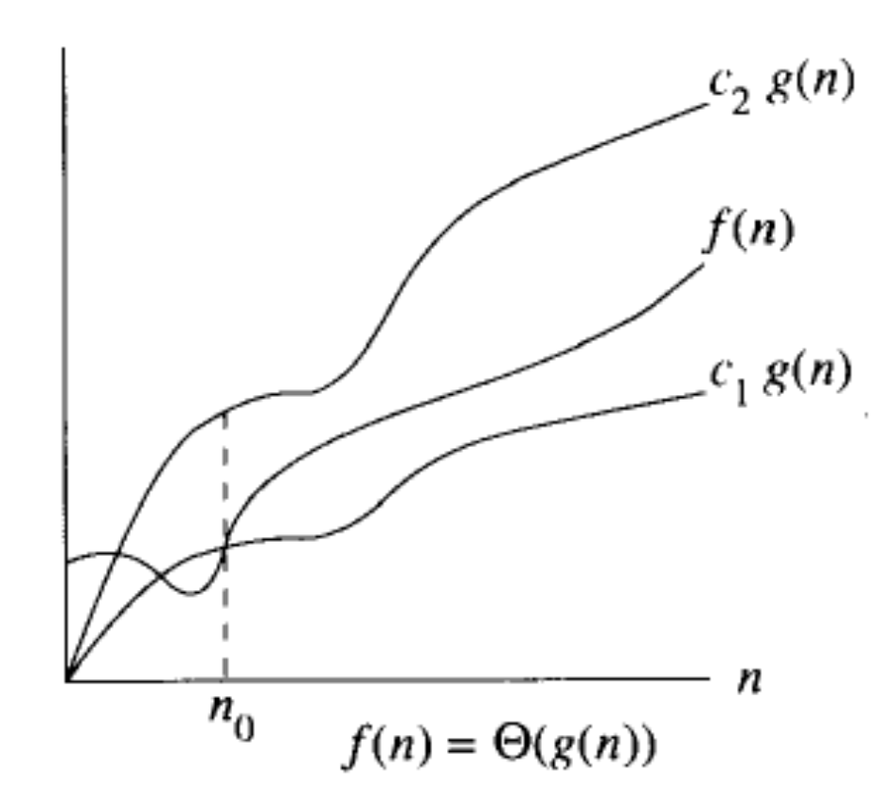
Θ-notation
Θ(g(n))={f(n): there exists positive constants c1 and c2 and n₀ ∈N such that 0≤ c1.g(n) ≤ f(n) ≤c2g(n) for n≥ n₀
For all for n≥ n₀, the function f(n) is equal to g(n) to with in a constant factor.

Slide 14
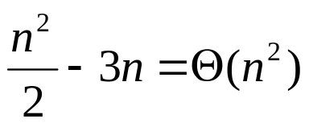
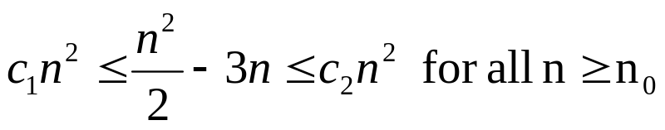
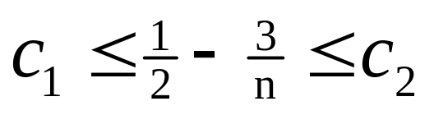
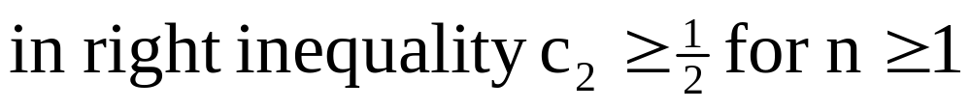
Θ-notation
Prove that
To do this we have to find out the value of positive constants c₁, c₂ and n₀ such that

Slide 15
Θ-notation
Prove that T(n)=n³ + 20n + 1 is O(n³)
T(n) is O(n³), if T(n) ≤ c2.n³ for some n≥ n₀ and a constant c>0.
So, n³ + 20n + 1 ≤ c2.n³ ➔ 1+20/n²+1/n³ ≤ c2.
If we select n≥ n₀ =1, c2 ≥22
If we select n₀ =10, c2 ≥1.201
Prove that T(n)=n³ + 20n + 1 is Ω(n³)
T(n) is Ω(n³), if T(n) ≥ c1.n³ for some n≥ n₀ and a constant c>0.
So, n³ + 20n + 1 ≥ c1.n³ ➔ 1+20/n²+1/n³ ≥ c1.
If we select n≥ n₀ =1, c1 ≤ 22
If we select n₀ =10, c1 ≤ 1.201

Slide 16
Properties
For any two function f(n) and g(n), f(n)=Θg(n) if and only if f(n)=O(g(n)) and f(n)=Ω(g(n)).

Slide 17
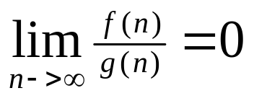
o-notation (little or small oh)
o(g(n)) = {f(n): for any constant c >0, there exists n₀ ∈N such that 0 ≤ f(n) < cg(n) for all n ≥n₀}.
  This bound is tighter.
  2n is o(n²), but 2n² ≠ o(n²).
o(g(n)) = f(n), for any constant c >0, there exists n₀ ∈N such that 0 ≤ f(n) < cg(n) for all n ≥n₀}
  Select srbitraily small c, then for large value of n the value of the ration f(n)/g(n) goes to zero.
    i.e.,

Slide 18
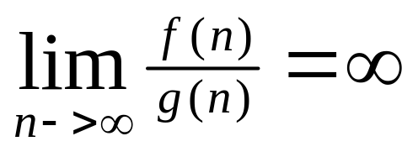
ω-notation
ω(g(n))={f(n): for any constant c>0 and n₀ ∈N such that 0≤ c.g(n) < f(n) for n≥ n₀
n²/2 is ω(n), but n²/2 ≠ ω(n²)
For a very large value of c, the value of f(n)/g(n)>c when n is also large. So we can show that

Slide 19
Transitivity properties
f(n)= Θ(g(n)) and g(n) = Θ(h(n)) ➔ f(n)= Θ(h(n))
f(n)= O(g(n)) and g(n) = O(h(n)) ➔ f(n)= O(h(n))
f(n)= Ω(g(n)) and g(n) = Ω(h(n)) ➔ f(n)= Ω(h(n))
f(n)= o(g(n)) and g(n) = o(h(n)) ➔ f(n)= o(h(n))
f(n)= ω(g(n)) and g(n) = ω(h(n)) ➔ f(n)= ω(h(n))

Slide 20
Properties
Reflexive
f(n)= Θ(f(n))
f(n)= O(f(n))
f(n)= Ω(f(n))
Symmetry
f(n)= Θ(g(n)) if and only if g(n)= Θ(f(n))
Transpose symmetry
f(n)= O(g(n)) if and only if g(n)= Ω(f(n))
f(n)= o(g(n)) if and only if g(n)= ω(f(n))

Slide 21
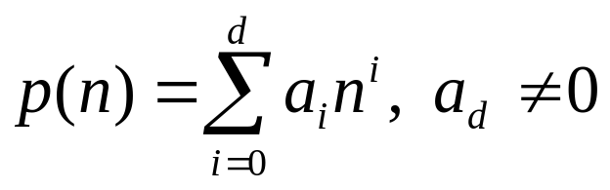
Properties
Given a positive integer d, a polynomial in n of degree d is a function p(n) of the form
the constants a₀, a₁,…, a_{d}, are coefficients of the polynomial,
then p(n)= Θ(n^{d}) or p(n)= O(n^{d}) or p(n)= Ω(n^{d}).

Slide 22
Properties
O(log_{a}(n)) is same as O(log_{b}(n))
  this for any notation, i.e., Theta or Omega notations.
  log_{a}(n) = log₂(n)/ log₂(a)
  So, we will talk about logarithmic growth, base in independent and represent by O(log(n)).
Complexity class

Slide 23
Simple rules of O-notation
Constant terms are expressed as O(1)
  For a constant c>0, O(C)=O(1).
Multiplicative constants are omitted:
  For c>0, O(c.T) = O(T)
Addition is performed by taking maximum:
  O(T1) + O(T2) = max{O(T1),O(T2)}
Multiplication is not changed, often rewritten in compact way
  O(T1).O(T2) = O(T1.T2)

Slide 24
Analysis of divide-and-conquer algorithms
Let the input problem of size n divides into subproblems of size n₁, n₂, n₃,…, n_{r}.
The running time of the problem is T(n)
Let t_{d}(n) and t_{c}(n) represents the time complexity of the divide step and combine step respectively. Then,
T(n) = t_{d}(n) + ∑T(n_{i}) + t_{c}(n) when n> certain value

Slide 25
Analysis of divide-and-conquer algorithms
Usually (not always) the subproblems are of same size, say, n/b and then
T(n) = r.T(n/b)+ f(n) when n> certain value and f(n)= t_{d}(n) + t_{c}(n)
If not of same size, sometimes we write the expression as (depending on the requirement)
T(n) ≤ r.T(n/b)+ f(n) n>c

Slide 26
Analysis of divide-and-conquer algorithms
Binary search: T(n) = T(n/2) + Θ(1)
Merge sort: T(n)= T(⎣n/2⎦) + T(⎡n/2⎤) + Θ(n)
Quick sort: T(n) = T(i) + T(n-i-1) + O(n)
Counting inver prob: T(n) ≤2T(n/2) + O(n)
Closest pair: T(n) + O(n log n), where T(n) = 2T(n/2) + O(n)
Integer multiplication: T(n) = 3T(n/2) + O(n)
Matrix multiplication:
  T(n) = 8T(n/2) + Θ(n²)
  T(n) = 7T(n/2) + Θ(n²)

Slide 27
Solution of recurrence relation
Three approaches:
  Substitution method
  Iteration method
  Master method

Slide 28
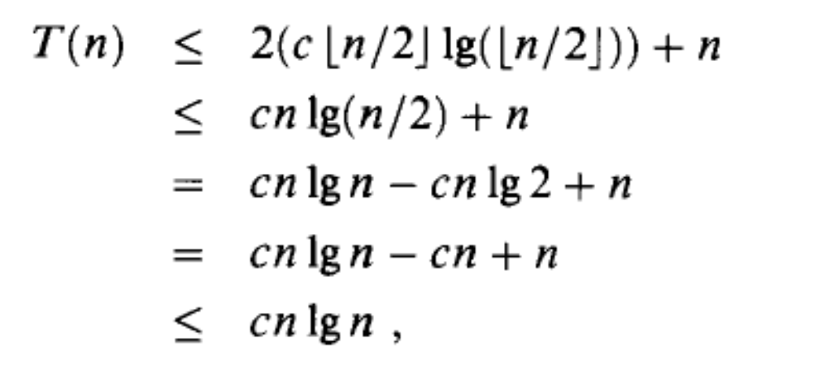
Substitution method
We ‘guess’ that a certain function is a solution (or an upper or lower bound on the solution) to the recurrence relation, and we verify that this correct by induction
Consider T(n) = 2T(⎣n/2⎦) + O(n), let T(n)=O(n log n)

Slide 29
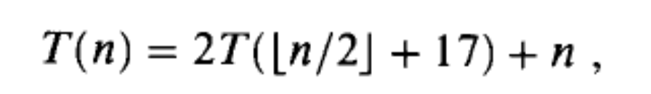
Substitution method
Making a good guess
Avoiding pitfalls
  T(n) = 2T(n/2) + n, let T(n) = cn for c>0
  T(n) = 2.c.n/2 + n = cn +n = O(n), a wrong sol.
  The initial assumption was wrong

Slide 30
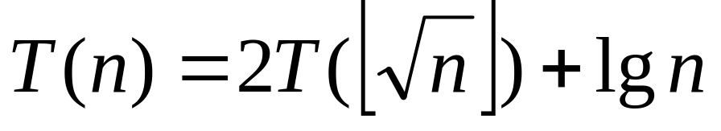
Substitution method
Changing variable:
Consider m = lg n ,i.e, n = 2^{m}
T(2^{m}) = 2T(2^{m/2}) + m
S(m) = 2S(m/2) + m
S(m)= O(m lg m)
T(n) = O(lg n lg lg n)

Slide 31
Iteration method
Repeatedly expand the recurrence relation using the same given form for the recurrence terms on the right side, until we reach th base the case, for which we can substitute the value given for the base case.
Finally, we have to apply the summation of the values, to find the bound

Slide 32
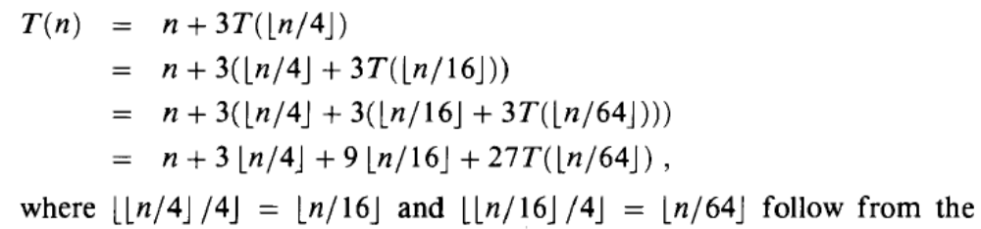
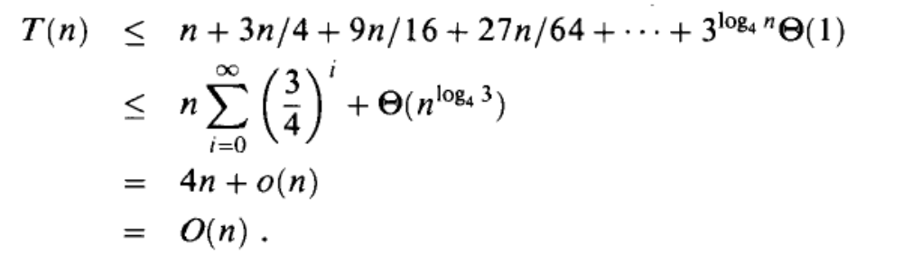

Iteration method
T(n) = 3T(⎣n/4⎦) + n

Slide 33
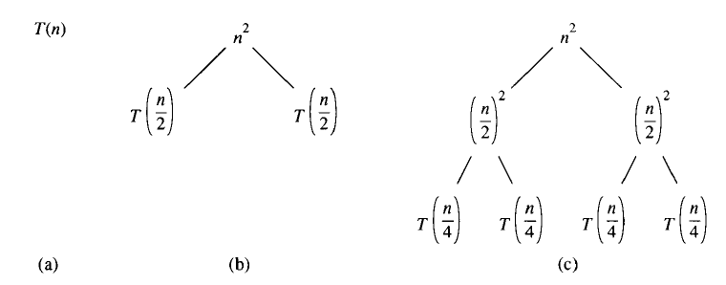
Recursion tree
A recursion tree is a way to visualize what happens when a recursion is iterated.
E.g., T(n) = 2T(n/2) + n²

Slide 34
The Master theorem
T(n) = a T(n/b) + Θ (n^{k}log^{p} n) where a ≥1, b>1, k ≥ 0 and p is real number
[log^{p} n ➔ log log ... N, log appears p times, e.g., log² n= log log n]
If a > b^{k}, then T(n)= Θ (n ^{log b a})
If a = b^{k},
  If p > -1 then T(n) = Θ (n ^{log b a} log ^{p+1} n)
  If p = -1 then T(n) = Θ (n ^{log b a} log log n)
  If p < -1 then T(n) = Θ (n ^{log b a})
If a < b^{k},
  If p ≥ 0, then T(n) = Θ (n^{k} log ^{p} n)
  If p < 0, then T(n) = O(n^{k})

Slide 35
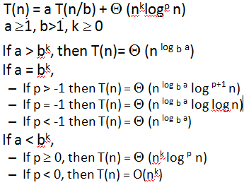
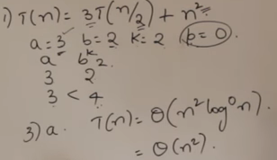
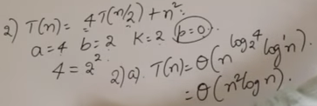

Slide 36
T(n)=T(n/2)+O(1) a=1, b=2, k=0, p=0
a=b^{k}, ➔ 2a Θ (n ^{log b a} log ^{p+1} n)= Θ (n ^{log 2 1} log¹n)= Θ (log n)
T(n)=2nT(n/2)+O(1)
T(n)=64 T(n/8) – nlog n
T(n)=4T(n/2)+O(log n) = Θ(n²)

Slide 37
T(n)= 3T(n/4)+ O(n) ➔ Θ(n)
T(n)=3T(n/4)+O(n log n) ➔ Θ(n log n)
T(n)=4T(n/2)+cn ➔ Θ(n²)
T(n)=3T(n/3)+√n ➔ Θ(n)
T(n)=3T(n/2)+n ➔ Θ(n ^{log 2 3})
T(n)=2T(n/2)+ √n ➔ Θ(n)
T(n)=√2T(n/2)+ log n ➔ Θ(√n)

Slide 38
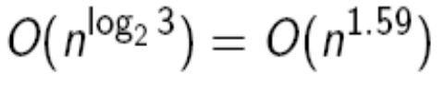
Analysis of divide-and-conquer algorithms
Binary search: T(n) = T(n/2) + Θ(1) [O(log n)]
Merge sort: T(n)= T(⎣n/2⎦) + T(⎡n/2⎤) + Θ(n)
Quick sort: T(n) = T(i); + T(n-i-1) + O(n) ?????
Counting inver prob: T(n) ≤2T(n/2) + O(n) [ O(n log n]
Closest pair: T(n) + O(n log n), where T(n) = 2T(n/2) + O(n) [ O(n log n)]
Integer multiplication: T(n) = 3T(n/2) + O(n)
Matrix multiplication:
  T(n) = 8T(n/2) + Θ(n²) [ Θ(n²) ]
  T(n) = 7T(n/2) + Θ(n²) [ Θ(n²) ]

Slide 39
Master theorem
T(n) =3T(n/4) + n lg n
a=3 and b=4, for ε=0.2,
Now test the regularity condition, af(n/b) ≤ cf(n) for some 0 <c <1
3(n/4) lg (n/4) ≤ (3/4) n lg n c=3/4.
By base 3, solution is T(n)= Θ(n lg n)

Slide 40
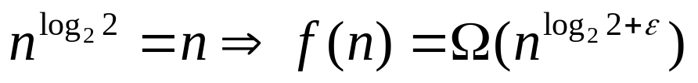
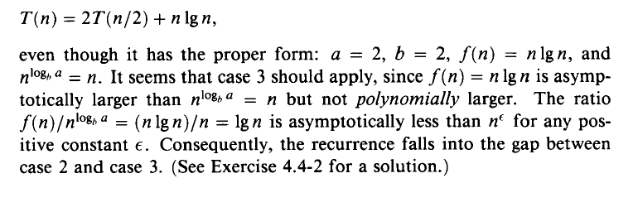
Master theorem
T(n) =2T(n/2) + n lg n
a=2 and b=2, for any ε,

Slide 41
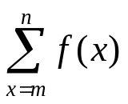
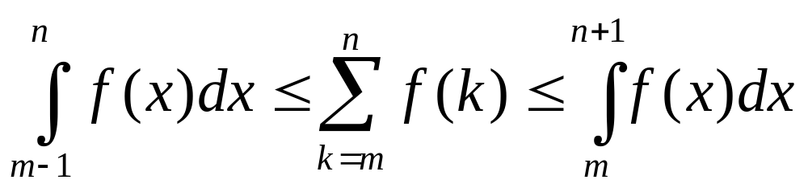
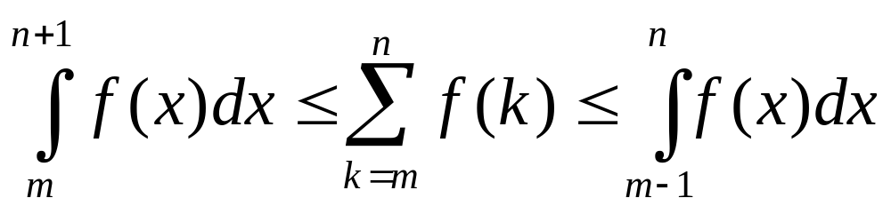
Bound of H_{n}
Let f(x) is a monotonically increasing function and then the sum can be expressed as
Similarly, if f(x) monotonically decreasing function then

Slide 42
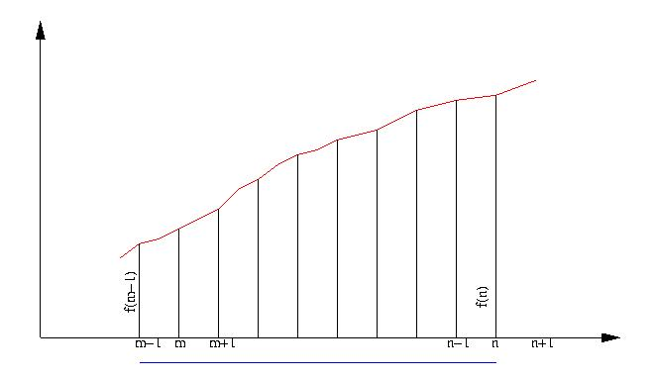
Approximation by integrals

Slide 43
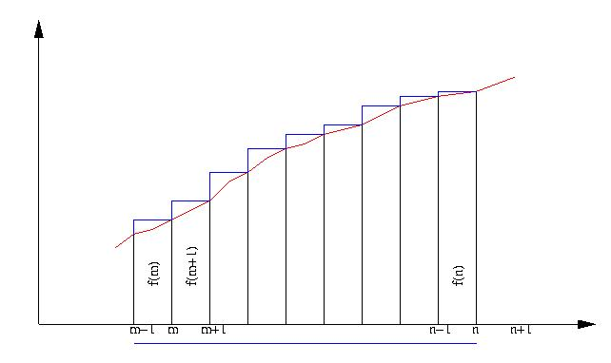

Slide 44
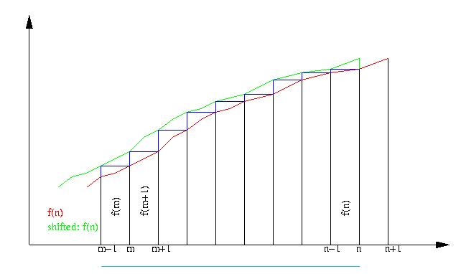

Slide 45
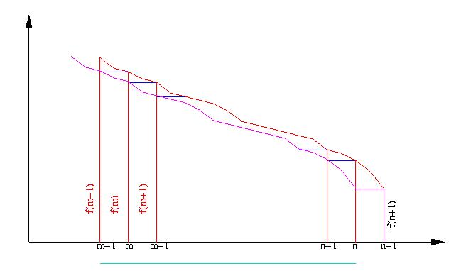

Slide 46
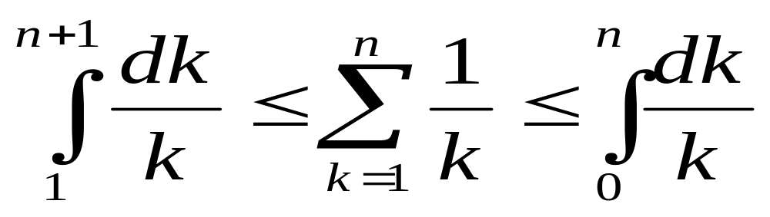
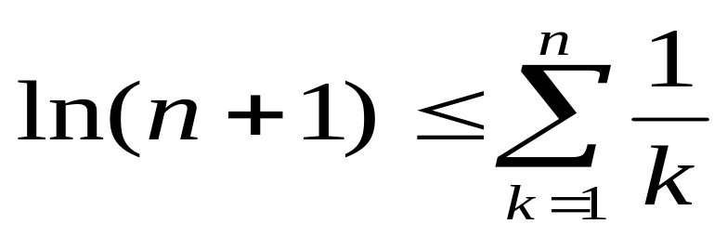
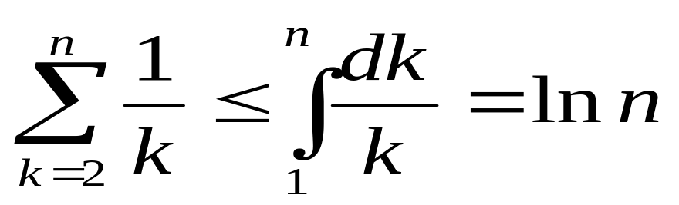
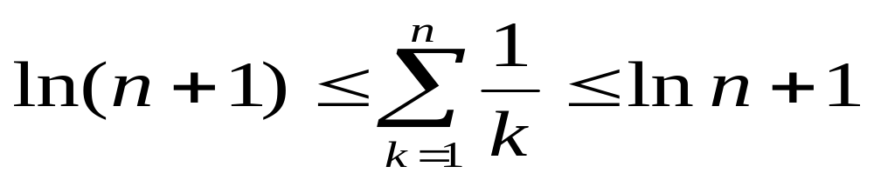
Consider f(k) = 1/k, for k>0

Slide 47
Average case quick sort
Assumptions:
  All elements are distinct
  Number of permutation depends on order of the input data set. We assume the data set as {1,2,…,n}.
  All permutation is equally likely
Let input list is any random permutation of {1, 2, …, n} and pivot element is ‘s’

Slide 48
Average case quick sort
After partition let the situation is as
(i₁, i₂, …, i_{s-1}, s, j_{s+1}, …., j_{n},)
(i₁, i₂, …, i_{s-1}) is a random permutation of {1, 2, …, s-1}
(j_{s+1}, j_{s+2}, …, j_{n}) is a random permutation of {s+1, s+2, …, n}

Slide 49
Average case quick sort
Qª(n) = avg. number of comparison done by ‘Partition( )’ on an input which is a random permutation of {1, 2, …, n}, then
Qª(0) = Qª(1) = 0
Qª(2) = 3
Any element can be a pivot element, prob (s: s is pivot)=1/n, 1≤ s ≤ n

Slide 50
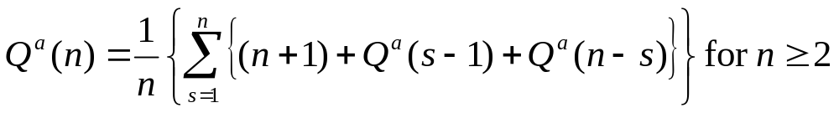
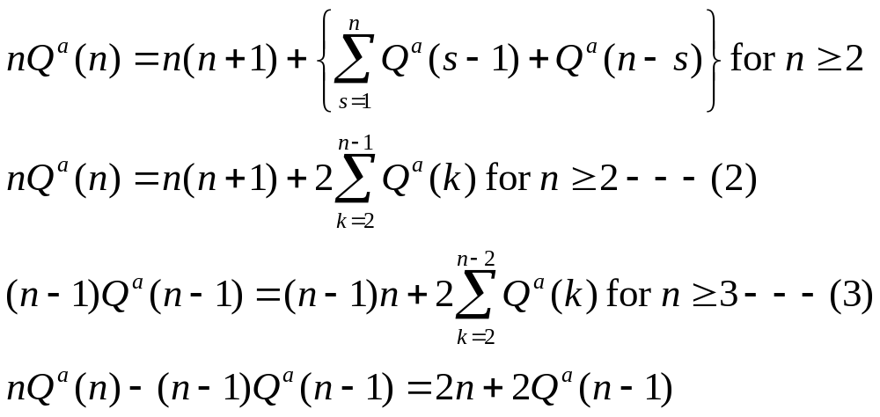
Average case quick sort

Slide 51
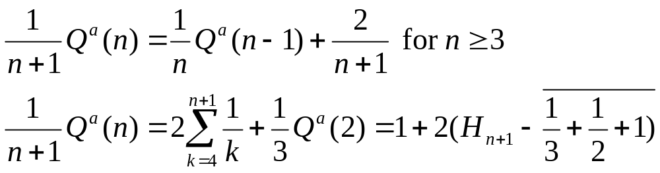
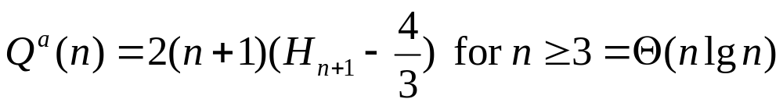
Average case quick sort

